Slide 1
Impact of Cool-Down Procedure and Residual Field on High Q₀ at Cornell
Dan Gonnella
For the Cornell Team
TTC Meeting
December, 2014

Slide 2
Main Conclusions
Trapped flux contributes stronger to residual losses in nitrogen-doped cavities than in EP+120ºC baked cavities.
Large spatial temperature gradients at the transition temperature reduce flux trapping, which can mitigate the above effect.
Thermal currents exist and can have an impact on cavity Q₀.
Practical Advice:
For best performance in cryomodule, cool down cavities with large transverse temperature gradients and small longitudinal temperature gradients.

Slide 3
Single-Cell Studies
Cornell nitrogen-doped 5 single-cell ILC shaped cavities.
These 5 cavities along with a nitrogen-doped cavity from FNAL, and EP cavity , and an EP+120ºC baked cavity were tested at Cornell.
Residual resistance was measured for a variety of cool down rates, spatial gradients, and applied external magnetic field.
Notes:
Table showing single and 9 cells

Slide 4
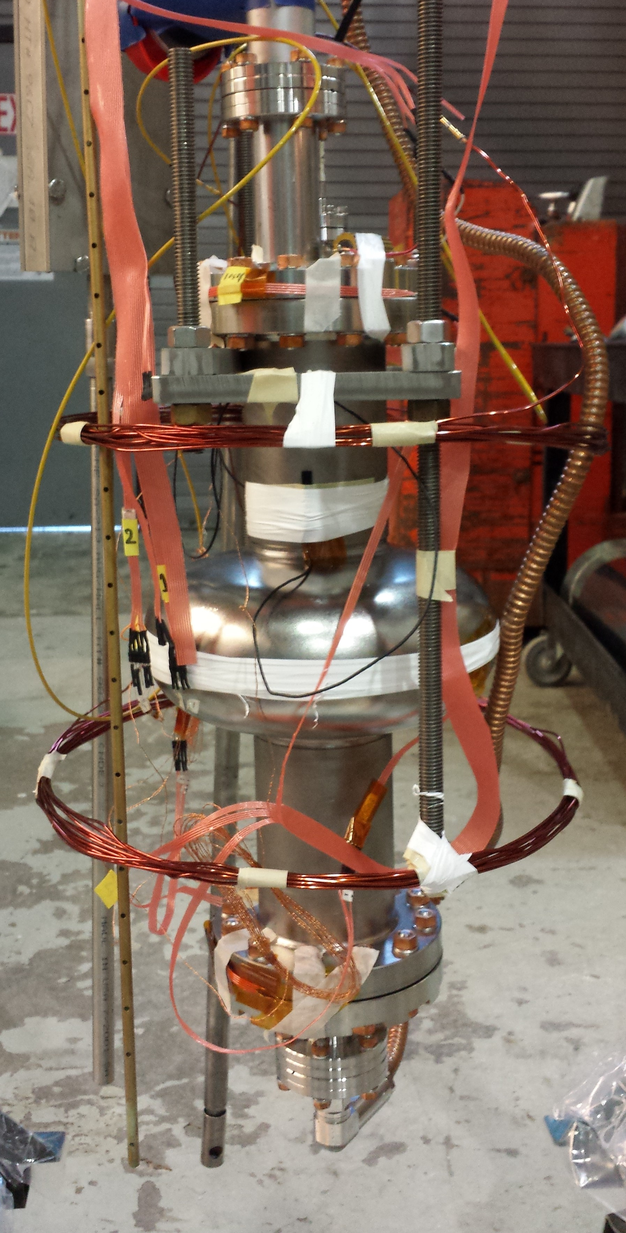
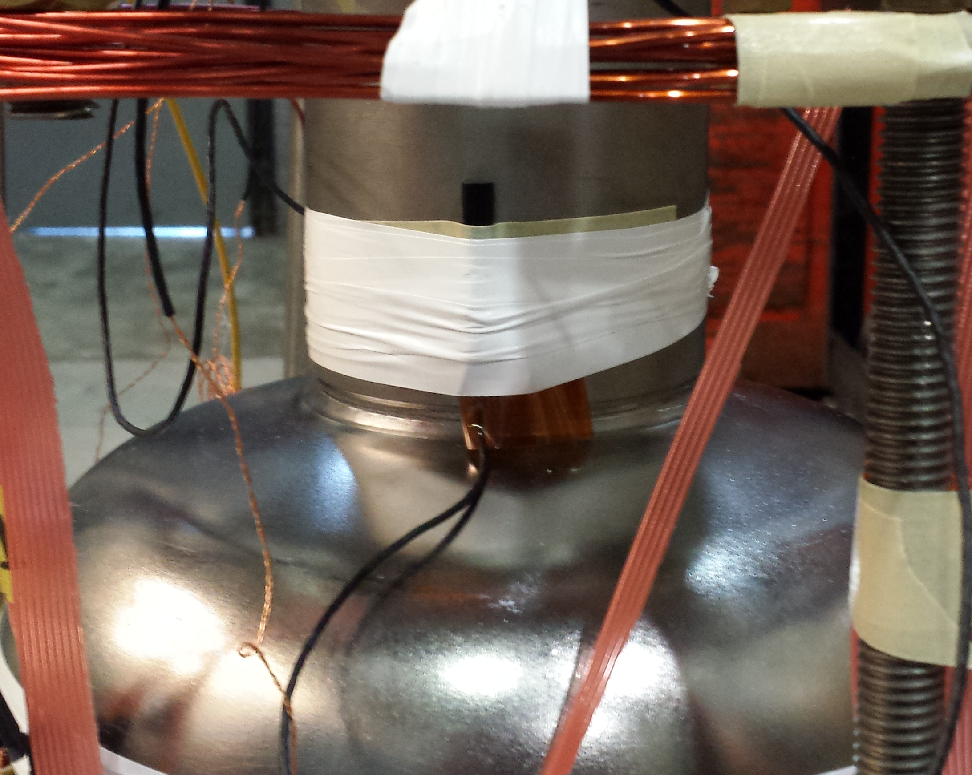
Experimental Setup
Slow Cool
Down System
Temperature Sensors
Fluxgate
Magnetometer
Helmholtz
Coil

Slide 5
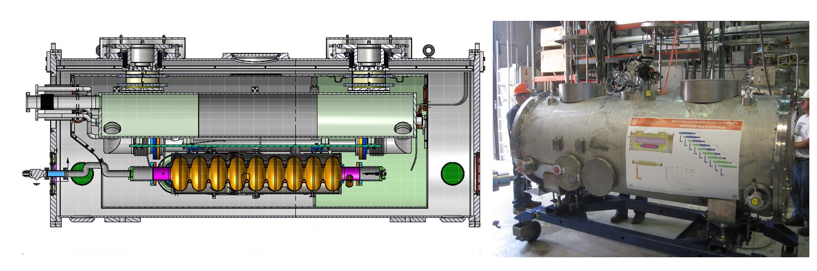
The HTC
The Cornell Horizontal Test Cryomodule (HTC) is a full cryomodule that can hold one 9-cell cavity.
Ambient magnetic fields are ~2 mG with 2 layers of magnetic shielding.
Two 9-cell nitrogen doped cavities have been tested so far in the HTC.
Temperature Sensors
Notes:
Very similar to LCLS-II cryomodule. 2 m section of the LCLS-II cryomodule. This is different than the HTS at FNAL or Jlab
Label things

Slide 6
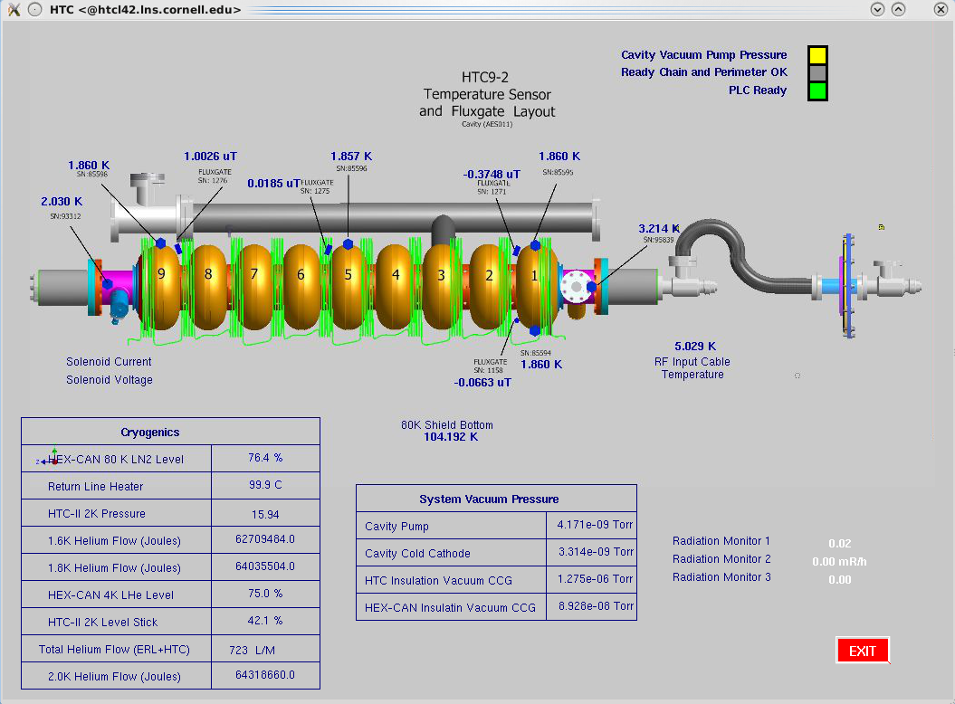
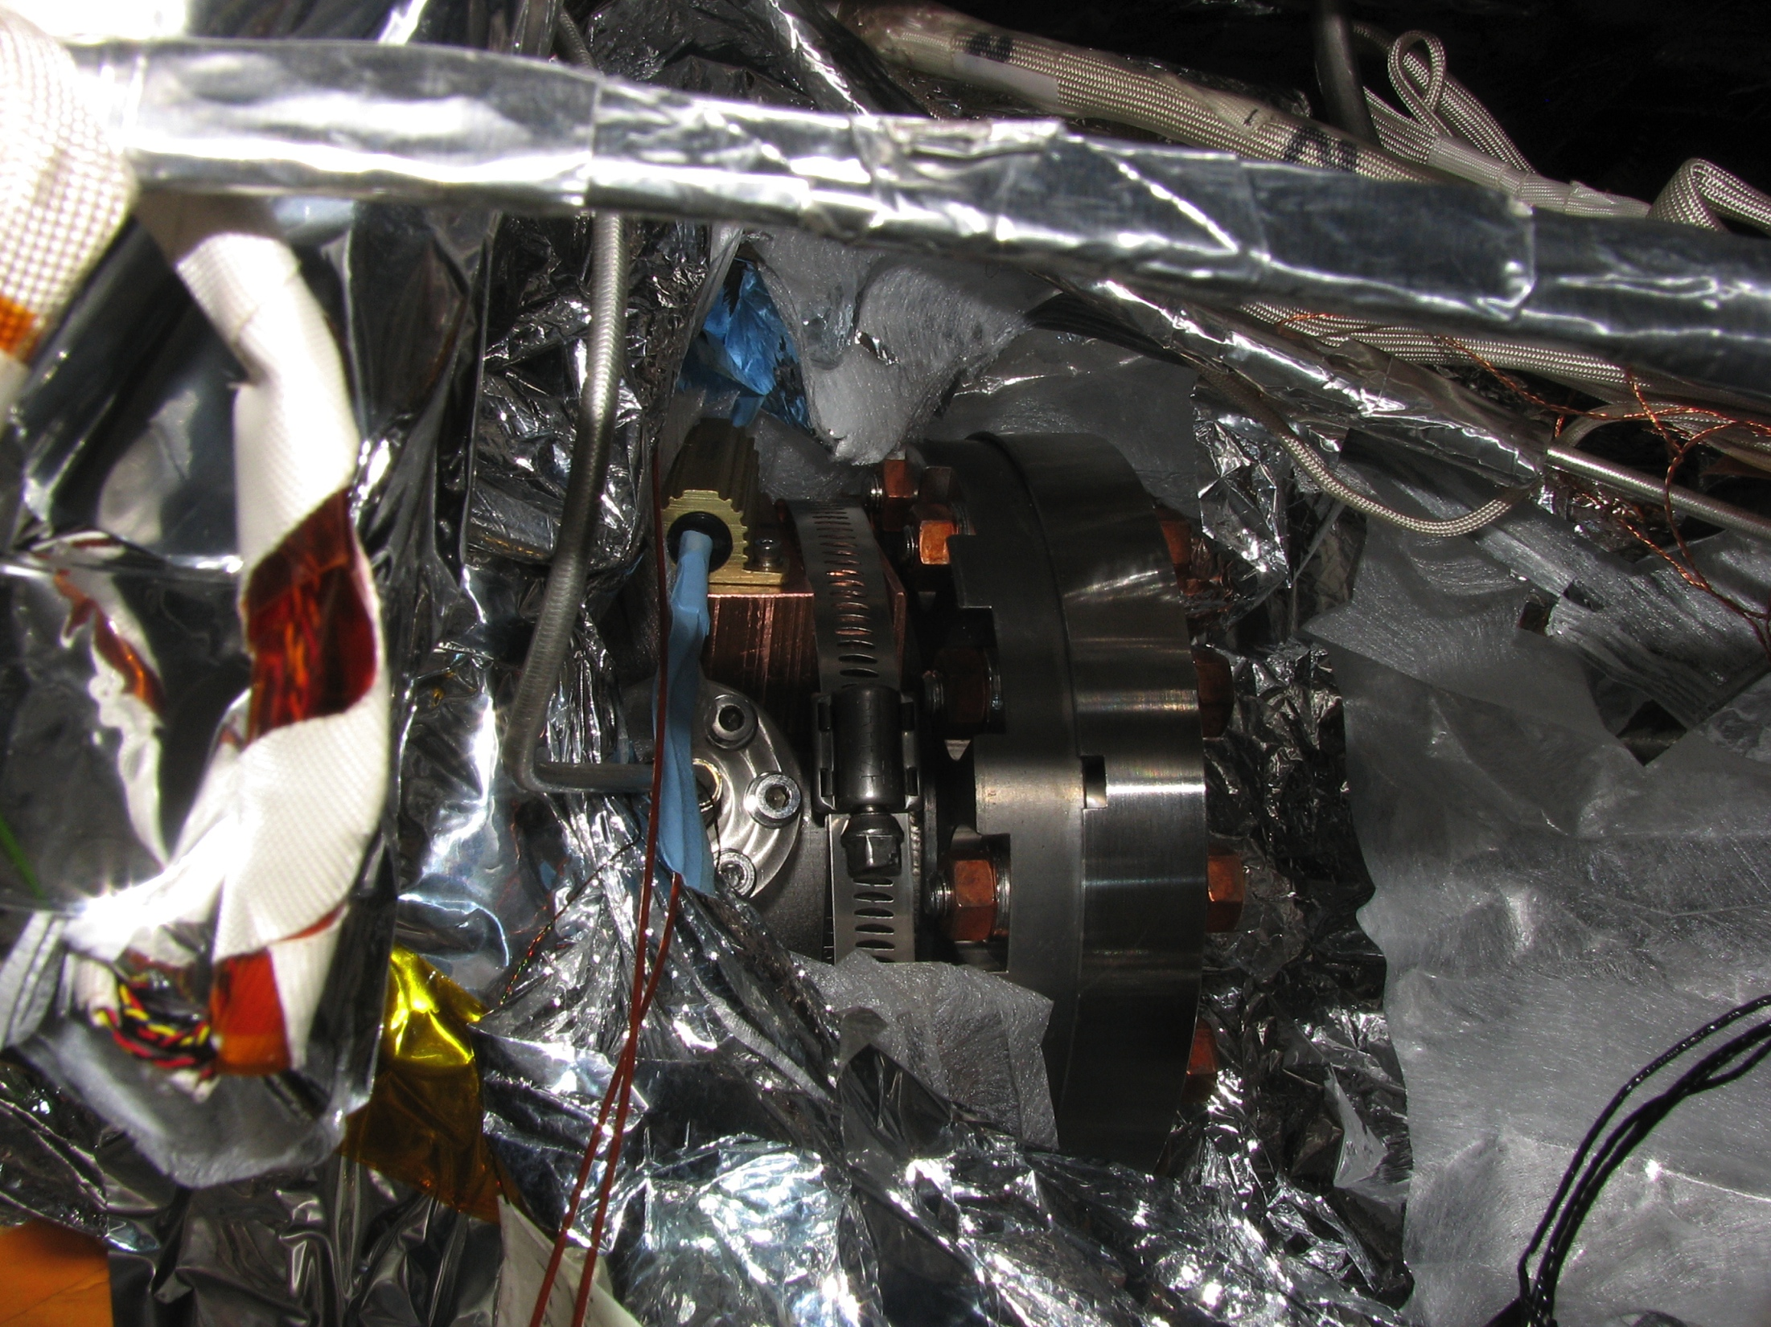
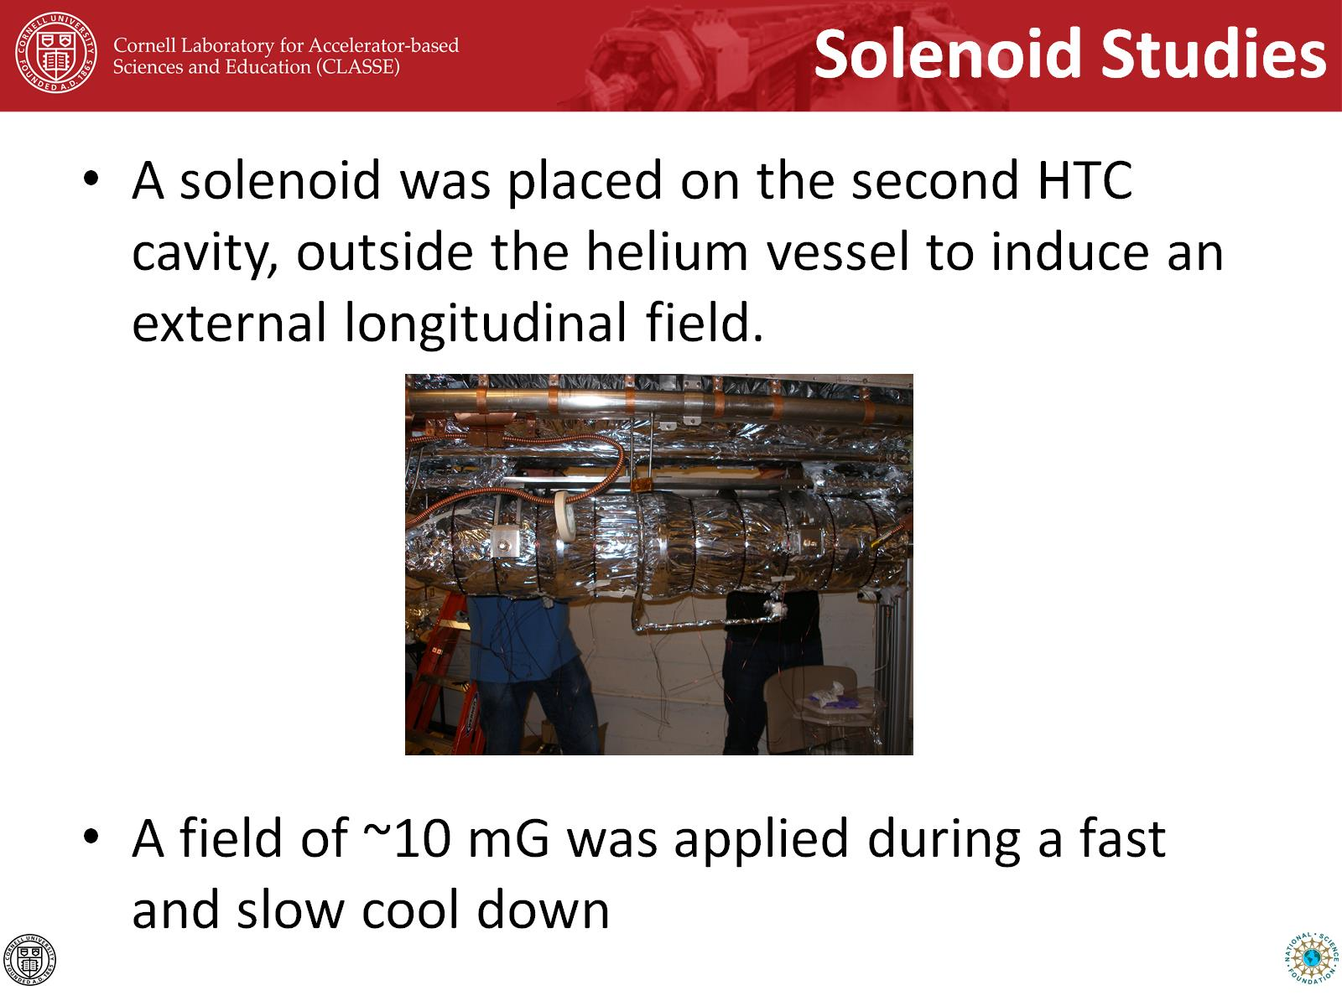
HTC Instrumentation
CNX Sensor
Fluxgate
CNX Sensor
CNX Sensor
Fluxgate
Fluxgate
Fluxgate
(transverse)
CNX Sensor
Heater on Beam Tube
Solenoid Around Cavity
Thanks to FNAL for providing fluxgates and CNX sensors.

Slide 7
Main Conclusions
Trapped flux contributes stronger to residual losses in nitrogen-doped cavities than in EP+120ºC baked cavities.
Large spatial temperature gradients at the transition temperature reduce flux trapping, which can mitigate the above effect.
Thermal currents exist and can have an impact on cavity Q₀.
Practical Advice:
For best performance in cryomodule, cool down cavities with large transverse temperature gradients and small longitudinal temperature gradients.

Slide 8
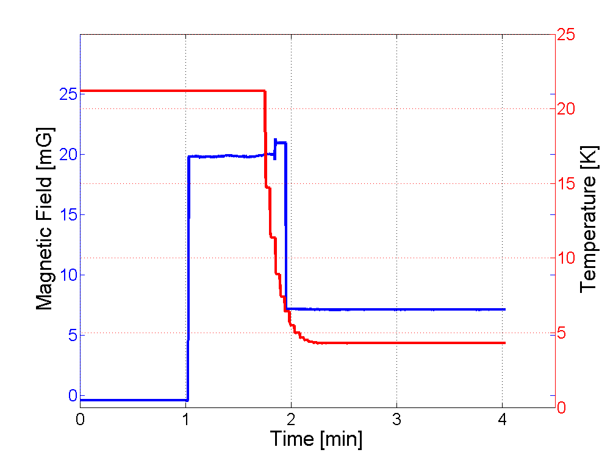
Fluxgate Measurements
T_{C}
External Field On
External Field Off,
Flux Trapped
External Field Off

Slide 9
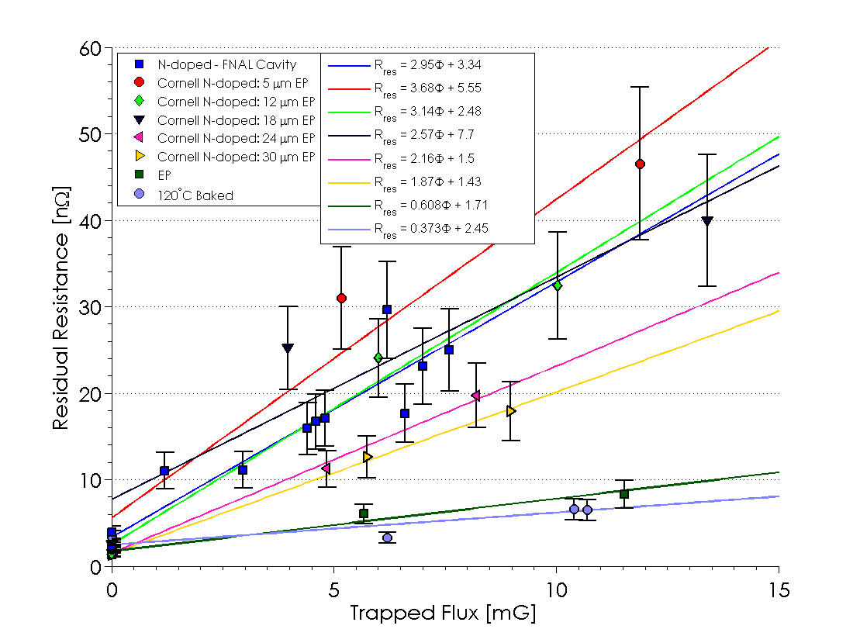
R_{res} vs Trapped Flux
Notes:
Add arrow that shows what types of cavities

Slide 10
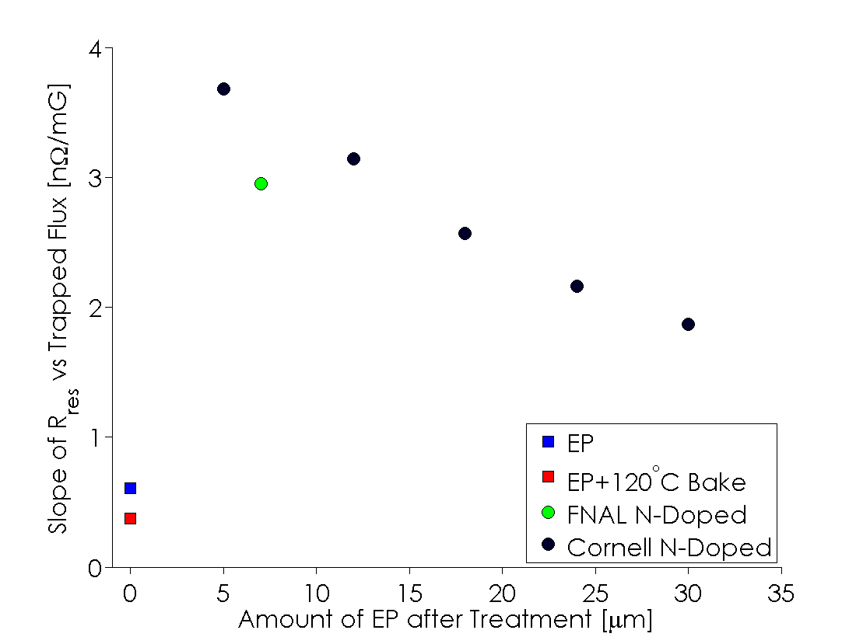
Sensitivity to Ambient Fields
Nitrogen-doped cavities are significantly more susceptible to residual losses from trapped flux than EP and EP+120ºC baked cavities.
Less nitrogen-doping results in less sensitivity.
There is ~2-4 nΩ of additional residual resistance per mG of trapped magnetic field in nitrogen-doped cavities.

Slide 11
Solenoid Studies in the HTC
A solenoid was placed around the second HTC cavity, outside the helium vessel to induce an uniform external longitudinal field.
A field of ~10 mG was applied during a fast and slow cool down to study sensitivity to ambient magnetic fields.

Slide 12
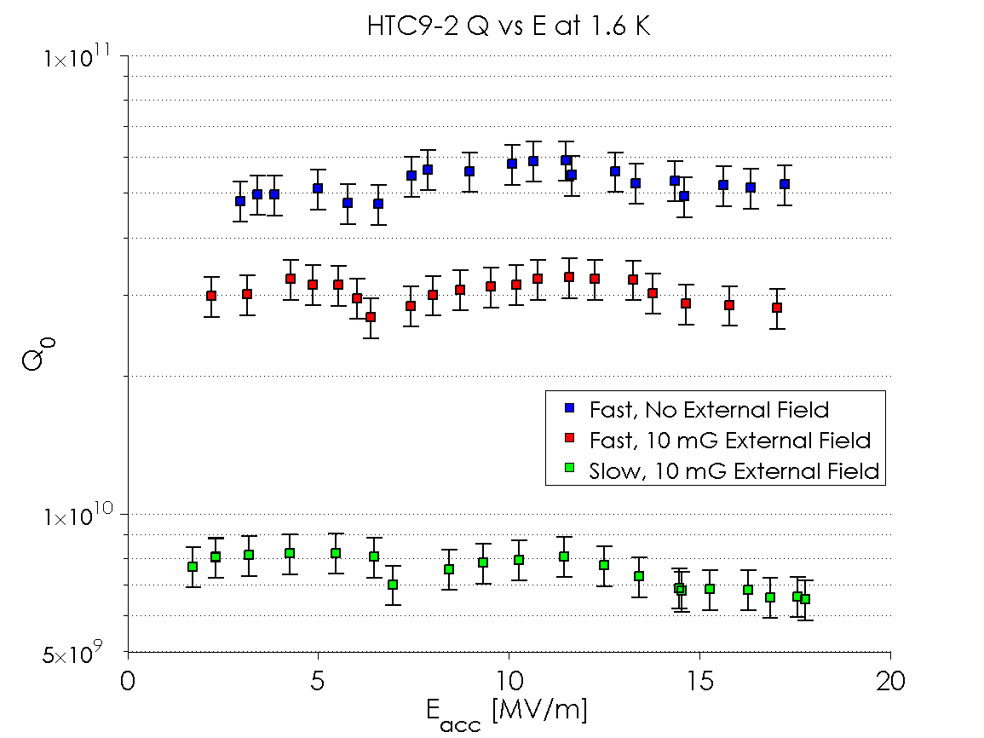
HTC Results
Cool Down | Solenoid On | Heater Used | ΔT_{long} [K] | ΔT_{trans} [K] | B_{long} (10 K) [mG] | B_{perp} (10 K) [mG] | Q₀ (2 K, 16 MV/m) | R_{res} (16 MV/m) [nΩ] | R_{BCS} (16 MV/m) [nΩ]
Fast 2 | No | No | 6.8 | 8.9 | 1.2 | 0.3 | 2.7x10¹⁰ | 4.5 | 5.8
Fast 3 | Yes | No | 5.9 | 7.0 | 10.1 | 7.2 | 1.9x10¹⁰ | 9.1 | 5.4
Slow 1 | Yes | No | 0.2 | 0.5 | 10.6 | 1.0 | 6.2x10⁹ | 40.5 | 4.5
ΔR_{res}=4.6 nΩ
ΔR_{res}=36 nΩ

Slide 13
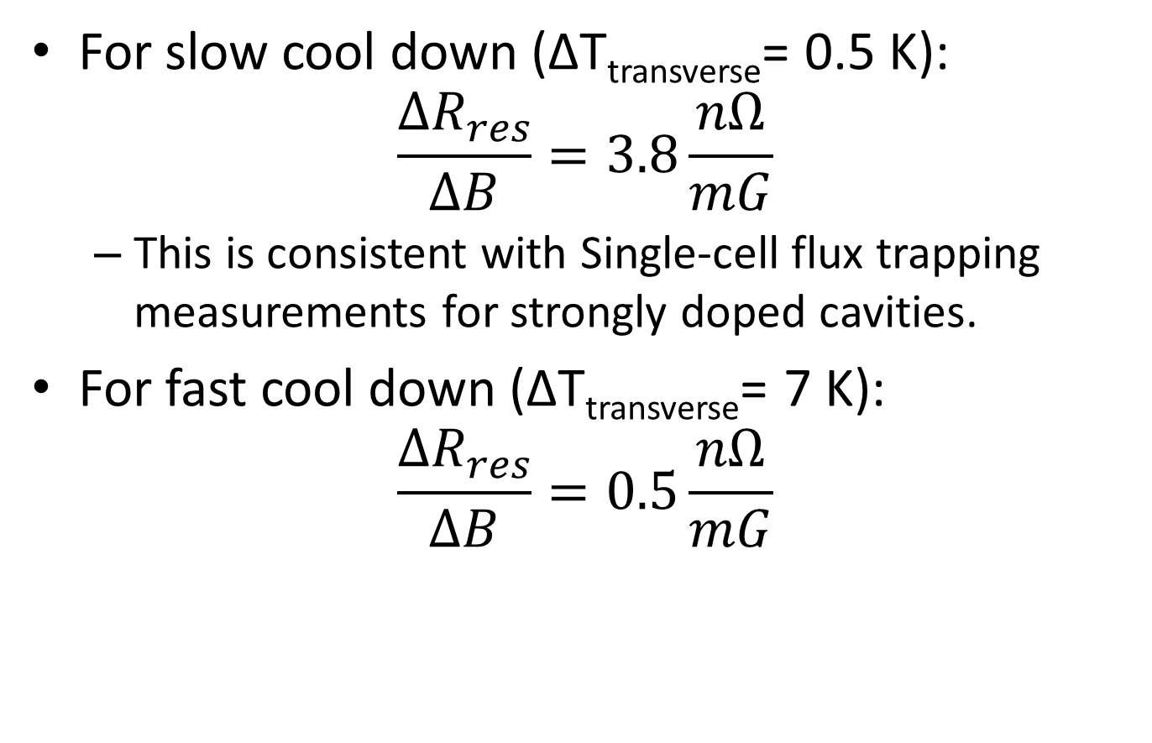
ΔR_{res} from External B
For slow cool down (ΔT_{transverse}= 0.5 K):
$$\frac{ΔR_{res}}{ΔB}=3.8\frac{nΩ}{mG}$$
This is consistent with Single-cell flux trapping measurements for strongly doped cavities.
For fast cool down (ΔT_{transverse}= 7 K):
$$\frac{ΔR_{res}}{ΔB}=0.5\frac{nΩ}{mG}$$

Slide 14
Main Conclusions
Trapped flux contributes stronger to residual losses in nitrogen-doped cavities than in EP+120ºC baked cavities.
Large spatial temperature gradients at the transition temperature reduce flux trapping, which can mitigate the above effect.
Thermal currents exist and can have an impact on cavity Q₀.
Practical Advice:
For best performance in cryomodule, cool down cavities with large transverse temperature gradients and small longitudinal temperature gradients.

Slide 15
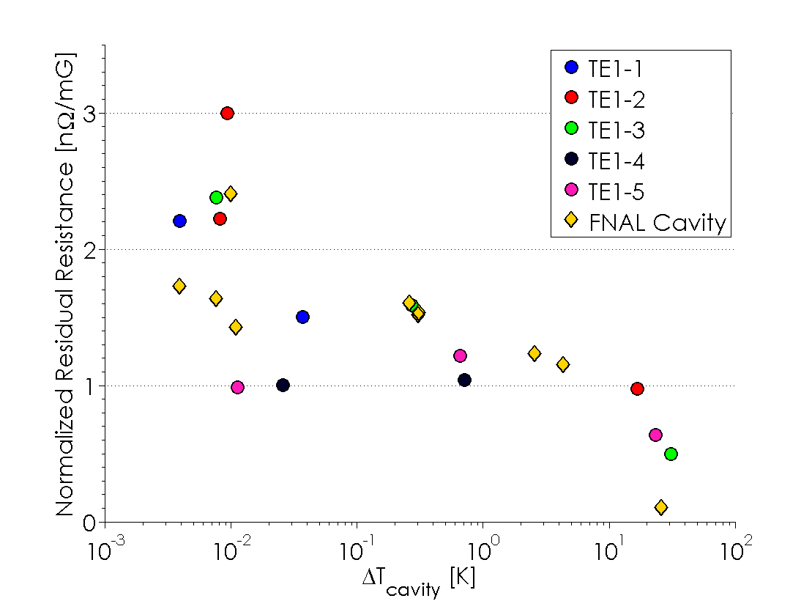
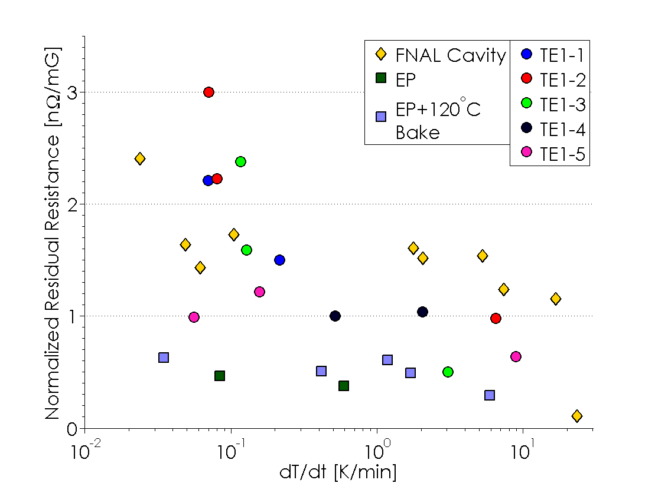
R_{res} vs Cool Down Rate
Residual Resistance (normalized to ambient magnetic field) vs Spatial Gradient and Cool Down Rate
Above a threshold gradient, residual resistance decreases with larger gradient due to higher flux expulsion.
The trend is not as pronounced with cool down rate.
Larger spatial temperature gradient is better for high Q₀.
Notes:
Clearer correlation with gradient than rate.

Slide 16
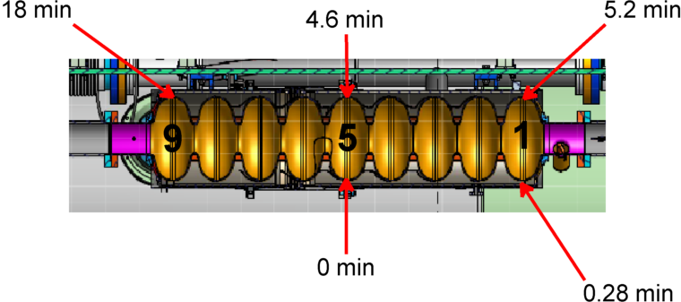
A Typical Cool Down in the HTC
Chimney
The time it takes between the first sensor going through T_{C} and a given sensor going through T_{C}
Helium Inlet
With an ILC tank:
The cavity cools from the bottom first.
Cell 5 cools first, cell 1 follows shortly after.
The top of cells 5 and 1 cool next.
The top of cell 9 cools last, significantly later.

Slide 17
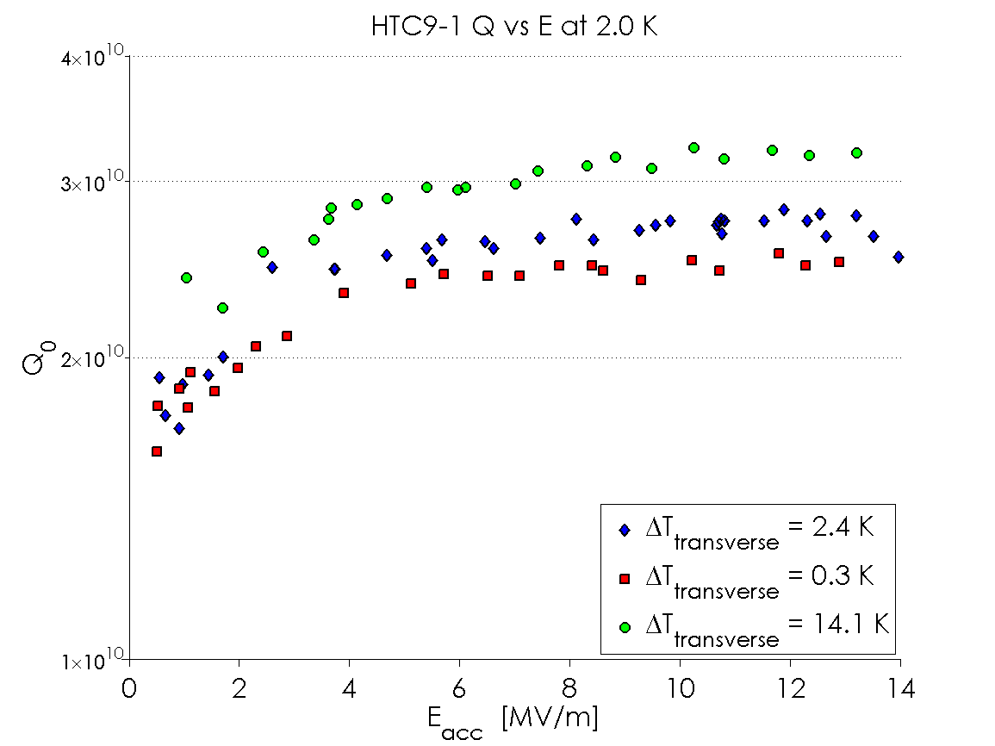
Q₀ vs E Dependence on Gradient
Larger transverse temperature gradients result in higher Q₀ (lower residual resistance)
Notes:
All at mostly the same speed (at speed) increase symbol size maybe change color

Slide 18
Main Conclusions
Trapped flux contributes stronger to residual losses in nitrogen-doped cavities than in EP+120ºC baked cavities.
Large spatial temperature gradients at the transition temperature reduce flux trapping, which can mitigate the above effect.
Thermal currents exist and can have an impact on cavity Q₀.
Practical Advice:
For best performance in cryomodule, cool down cavities with large transverse temperature gradients and small longitudinal temperature gradients.

Slide 19
Heater Studies
A heater was installed on one cell 9 beam tube in order to induce a large longitudinal thermal gradient.
Hope was that this will reduce flux trapping and improve Q₀
Heat this end
Cool from this end
Cryo inlet

Slide 20
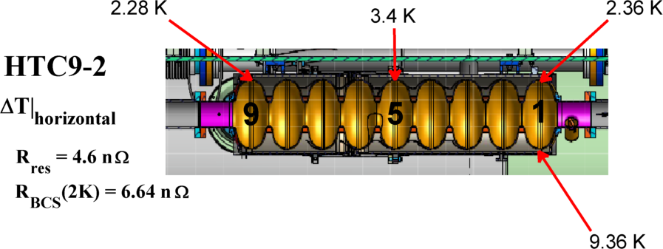



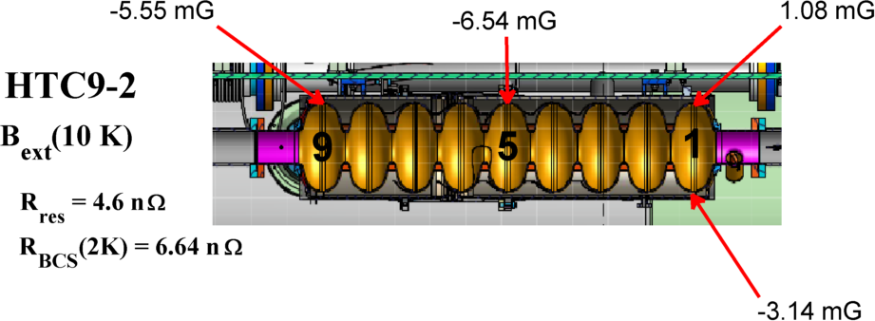

Fast Cool-Down with and without Beam Tube Heater
Without Heater
With Heater
Larger longitudinal (horizontal) ΔT!

Slide 21
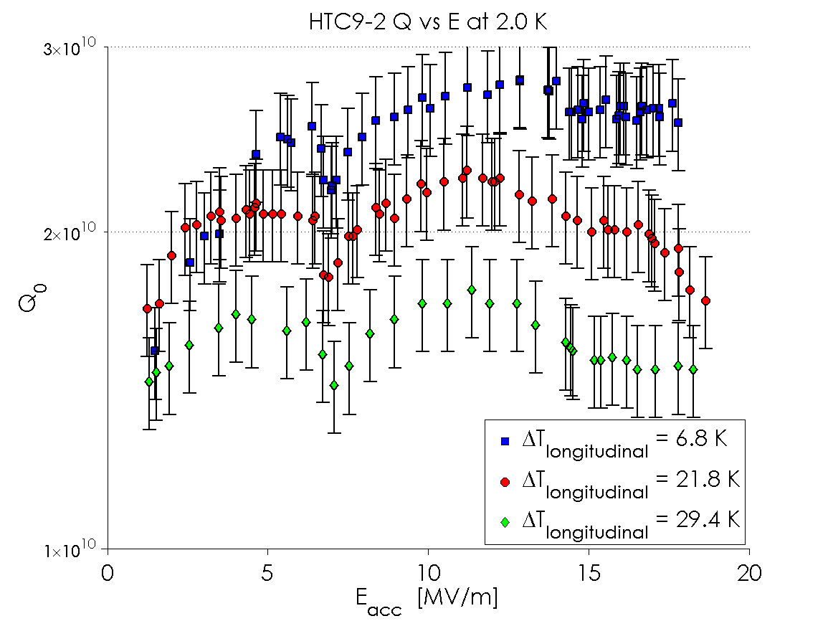
Heater Studies, cont.
Cool Down | Solenoid On | Heater Used | ΔT_{long} [K] | ΔT_{trans} [K] | B_{long} (10 K) [mG] | B_{perp} (10 K) [mG] | Q₀ (2 K, 16 MV/m) | R_{res} (16 MV/m) [nΩ] | R_{BCS} (16 MV/m) [nΩ]
Fast 2 | No | No | 6.8 | 8.9 | 1.2 | 0.3 | 2.7x10¹⁰ | 4.5 | 5.8
Fast 4 | No | Yes, 50 W | 21.8 | 32.5 | 2.5 | 50.3 | 2.1x10¹⁰ | 7.3 | 6.0
Fast 6 | No | Yes, 100 W | 29.4 | 39.4 | 3.1 | 62.8 | 1.5x10¹⁰ | 11.9 | 6.3
Experiment:
Larger longitudinal ΔT gives lower Q₀ in a cryomodule!

Slide 22
What we’ve seen so far:
Transverse gradients are good.
Longitudinal gradients are bad.
Why?

Slide 23
Fast Cool-Down with and without Beam Tube Heater
Without Heater
With 50 W Heater
Larger longitudinal (horizontal) ΔT
Large difference in transverse magnetic field!

Slide 24
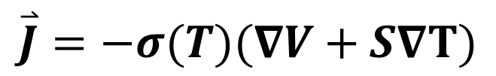
Heater Studies: Why Q₀ went down
Larger horizontal temperature gradient:
Horizontal ΔT drives thermal current
Current produces large transverse magnetic field
In vertical tests, rotational symmetry of the cavity results in no magnetic fields at inner cavity surface
BUT: In horizontal cavity tests, symmetry is broken due to vertical temperature gradients!!
$$\overset{⃑}{J}=−σ(T)(∇V+S∇T)$$

Slide 25
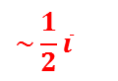
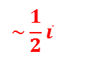
Thermal Currents in VT vs HT
Vertical Test
Horizontal Test
T_{HOT}
$$\sim \frac{1}{2}\overline{i}$$
i₂
T_{HOT}
T_{COLD}
i₁
i
i
i
$$\sim \frac{1}{2}\overline{i}$$
Cavity cools from bottom and conductivity σ= σ(T)
Cylindrical symmetry is broken by transverse (vertical) temperature gradient and current will preferentially flow through the bottom of the cavity.
This results in a non-zero magnetic field at the cavity inner surface.
Magnetic fields from thermal currents are important in horizontal test!
T_{COLD}
Cylindrical symmetry results in no magnetic field at cavity inner surface

Slide 26
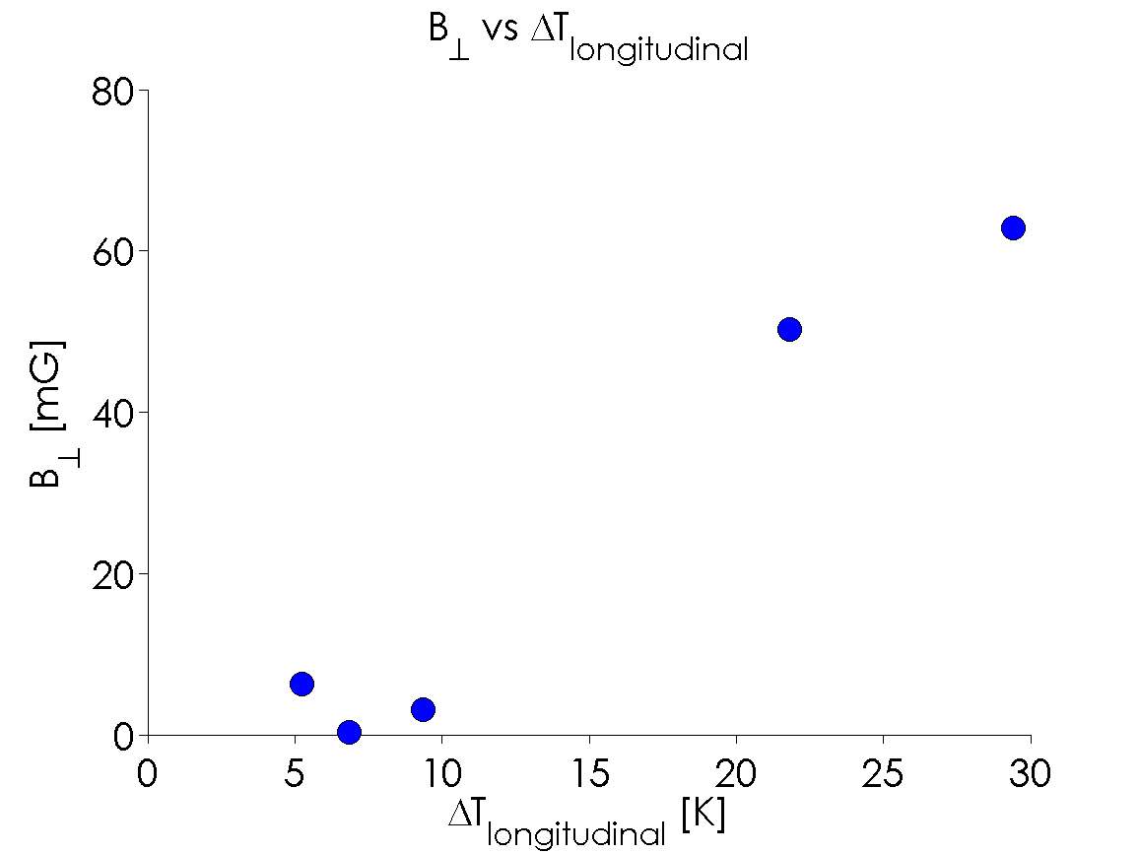
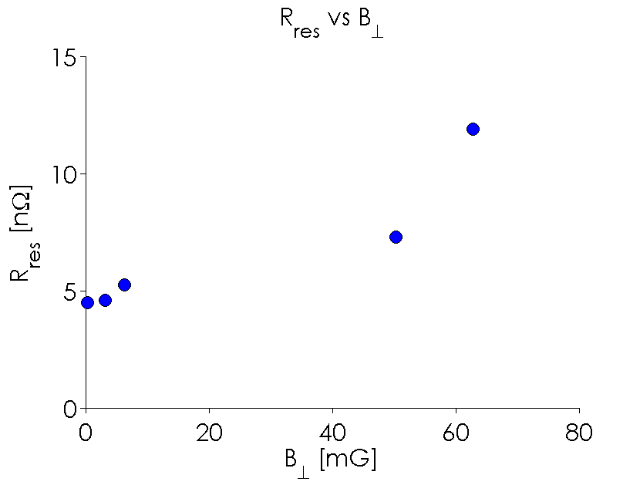
Heater Studies
Larger longitudinal temperature gradient causes a larger perpendicular magnetic field by thermal currents.
Larger perpendicular magnetic field causes significant increases in R_{res} even with large transverse gradients (unlike in vertical test).

Slide 27
Main Conclusions
Trapped flux contributes stronger to residual losses in nitrogen-doped cavities than in EP+120ºC baked cavities.
Large spatial temperature gradients at the transition temperature reduce flux trapping, which can mitigate the above effect.
Thermal currents exist and can have an impact on cavity Q₀.
Practical Advice:
For best performance in cryomodule, cool down cavities with large transverse temperature gradients and small longitudinal temperature gradients.

Slide 28
Thank you for your attention!
Two papers on these topics on arXiv:
Nitrogen-Doped 9-Cell Cavity Performance in a Test Cryomodule for LCLS-II. D. Gonnella et. al. arXiv: 1411.1659
Thermocurrents and their Role in high Q Cavity Performance. R. Eichhorn et. al. arXiv: 1411.5285

Slide 29
A Typical Cool Down in the HTC

Slide 30

Fast Cool Down Dynamics
Fluxgates parallel to cavity axis
Fluxgate perpendicular to cavity axis
Fast cool-down with speeds similar to cool-down in vertical tests.
Low magnetic fields, including low transverse fields by thermal currents
Relative small horizontal temperature gradients (good, see later)
Relative large vertical temperature gradients (good, see later)
Note: Rates and gradients are defined for when that given sensor goes through T_{C}

